Slide 1


SAVING RYAN’S PRIVATES
Addressing the complex security problems around leaky nudes
Johnny Xmas, CISSP, GIAC
Technical Director of Training, GRIMM

Slide 2

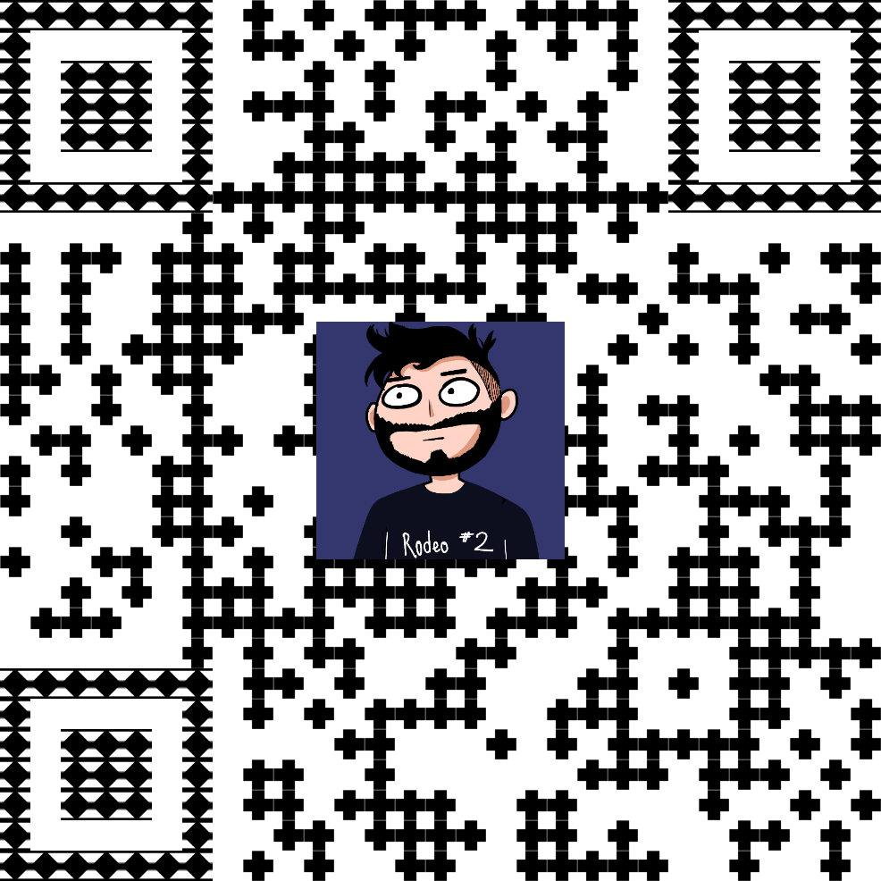


Requisite Slide of
Stuff you don’t Care About
Music Major
Urban Explorer
Crime Simulator
Educator
Community Leader
HACKER

Slide 3

What did you just
get Yourself Into?
WHY the things we already know are critical
Blind spots and lesser-understood attack vectors
Reality check on what you can do

Slide 4

STATS!

Slide 5

STATS!
I was gonna try to Google some stats,
so you just go do that.
It’s impossible to accurately
track this, anyway.
WE ALL KNOW THIS IS
A HUGE PROBLEM.
YOU DON’T NEED THE STATS.

Slide 6
QUIZ REVIEW!

Slide 7

UNIQUE PASSWORDS
Billions of credentials are leaked/shared every year from hacked systems
Vendors rarely directly inform their users
Attackers “spray” these credentials at OTHER sites & services

Slide 8
COMPLEX PASSWORDS
Increase the amount of time necessary for an attacker to guess (“crack”) them
Does not help if you reuse passwords
Easy AF when you use a PW manager

Slide 9
Multi-Factor Auth.
Like having 2 passwords, one of which rotates every few seconds
Great even when your password sucks
Requires attacker to access the device or service that has your “seed token”

Slide 10
So How do Leaks Happen, Then?

Slide 11

Your Partner Sucks
(In the bad way)
Intentional Leaks
Their cybersecurity posture sucks
You’re both using a non-encrypting messaging system
No End-to-End (“E2E”) Encryption
No Message Expiration

Slide 12
Your Partner Sucks
(In the bad way)
Intentional Leaks
Their cybersecurity posture sucks
They’re using a non-encrypting messaging system
No End-to-End Encryption
No Message Expiration
IT IS IMPOSSIBLE FOR ANY GROUP CHAT TO HAVE E2E ENCRYPTION.

Slide 13
You’re Using
Somebody Else’s Computer
You didn’t know
You do this constantly
It’s required for many (most) scenarios

Slide 14


Slide 15


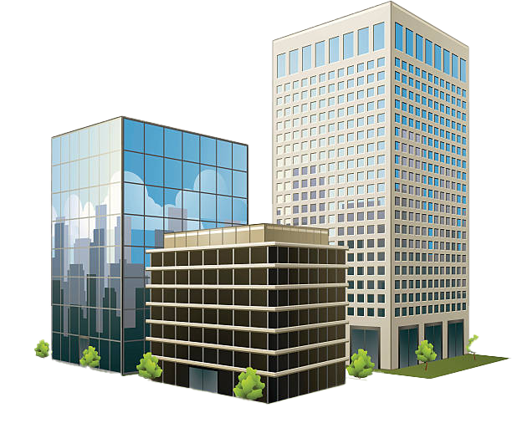

Slide 16
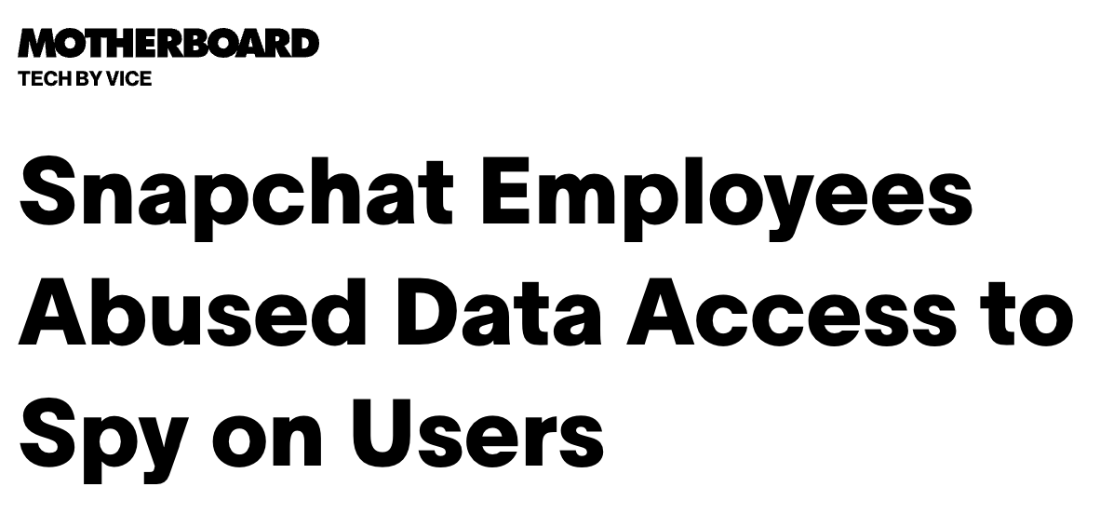
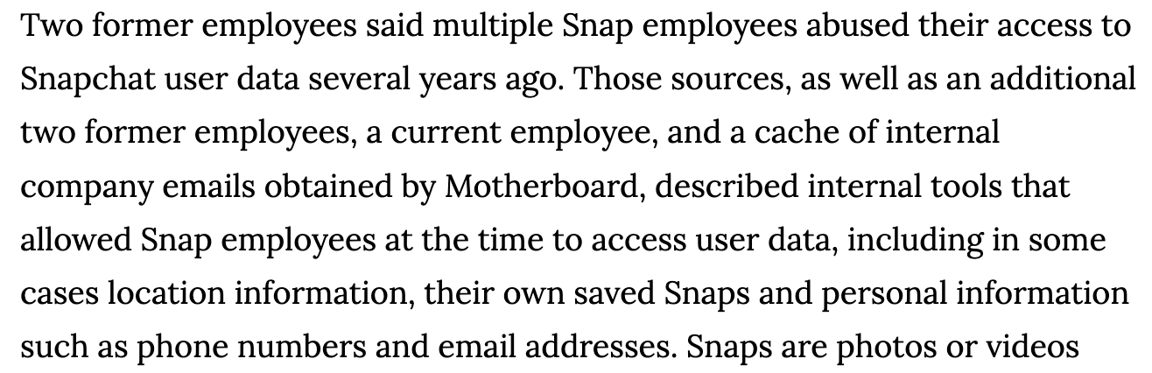
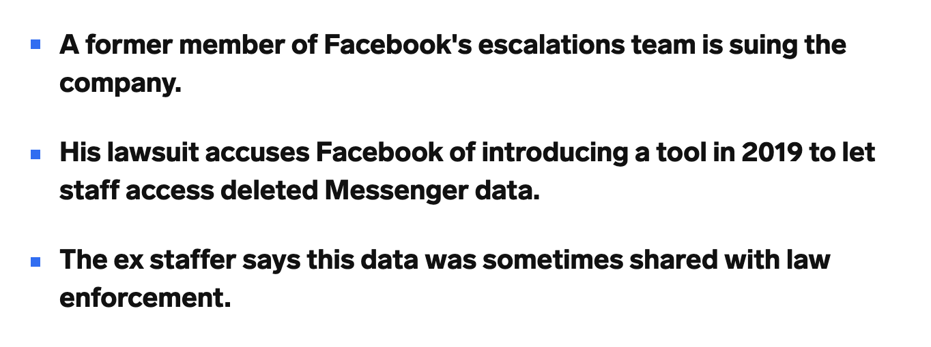
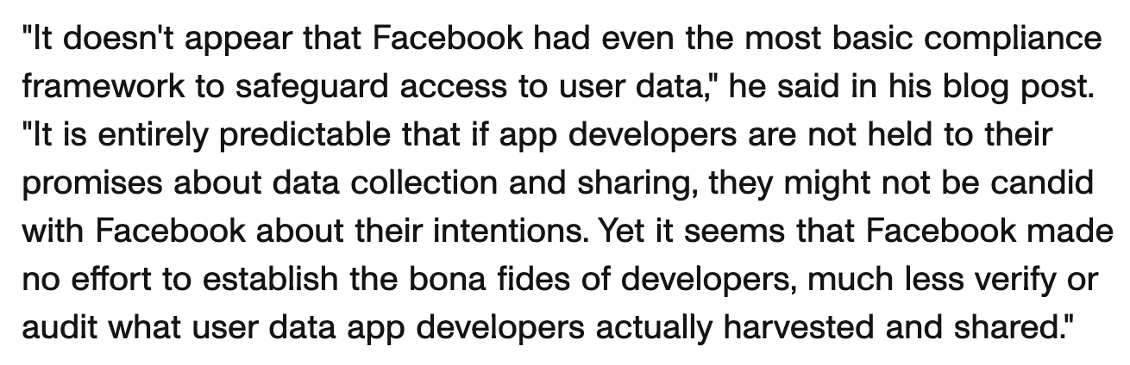

Slide 17
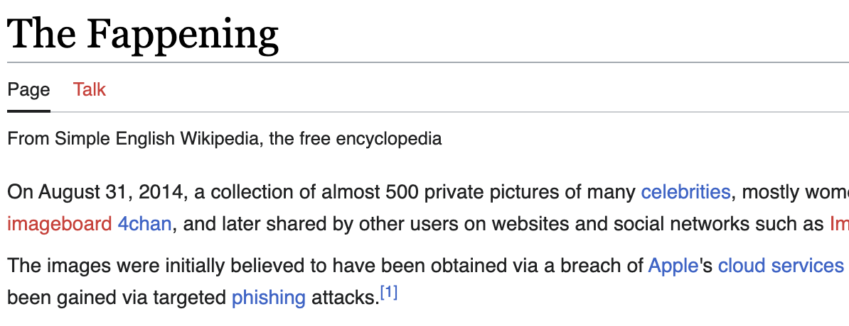
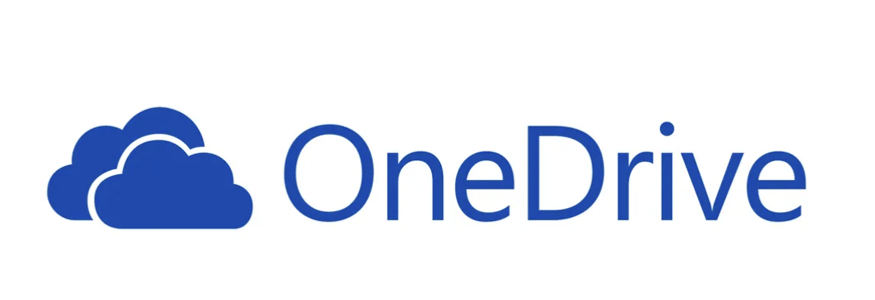

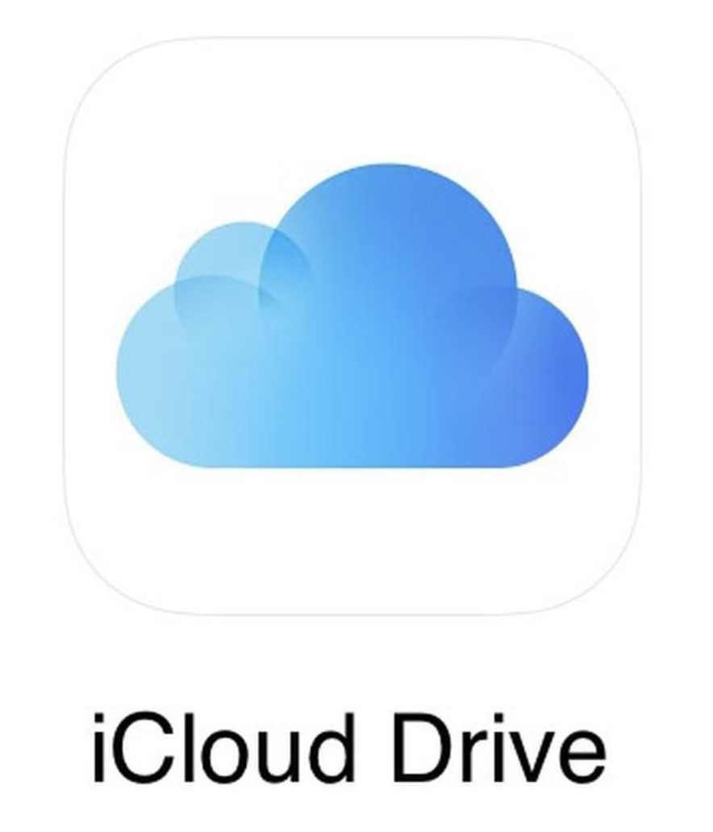

You’re Using
Somebody Else’s Computer

Slide 18
IT IS IMPOSSIBLE FOR ANY GROUP CHAT TO HAVE E2E ENCRYPTION.

Slide 19
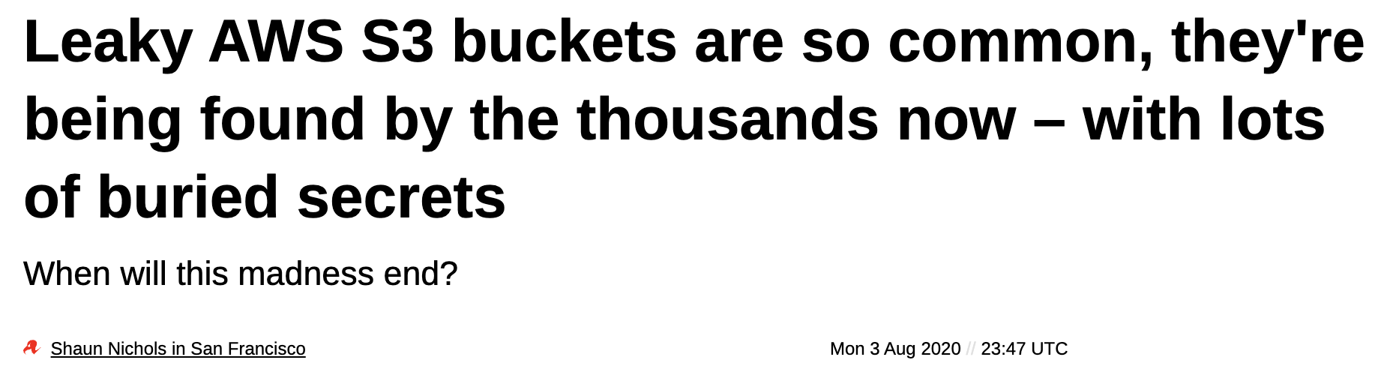
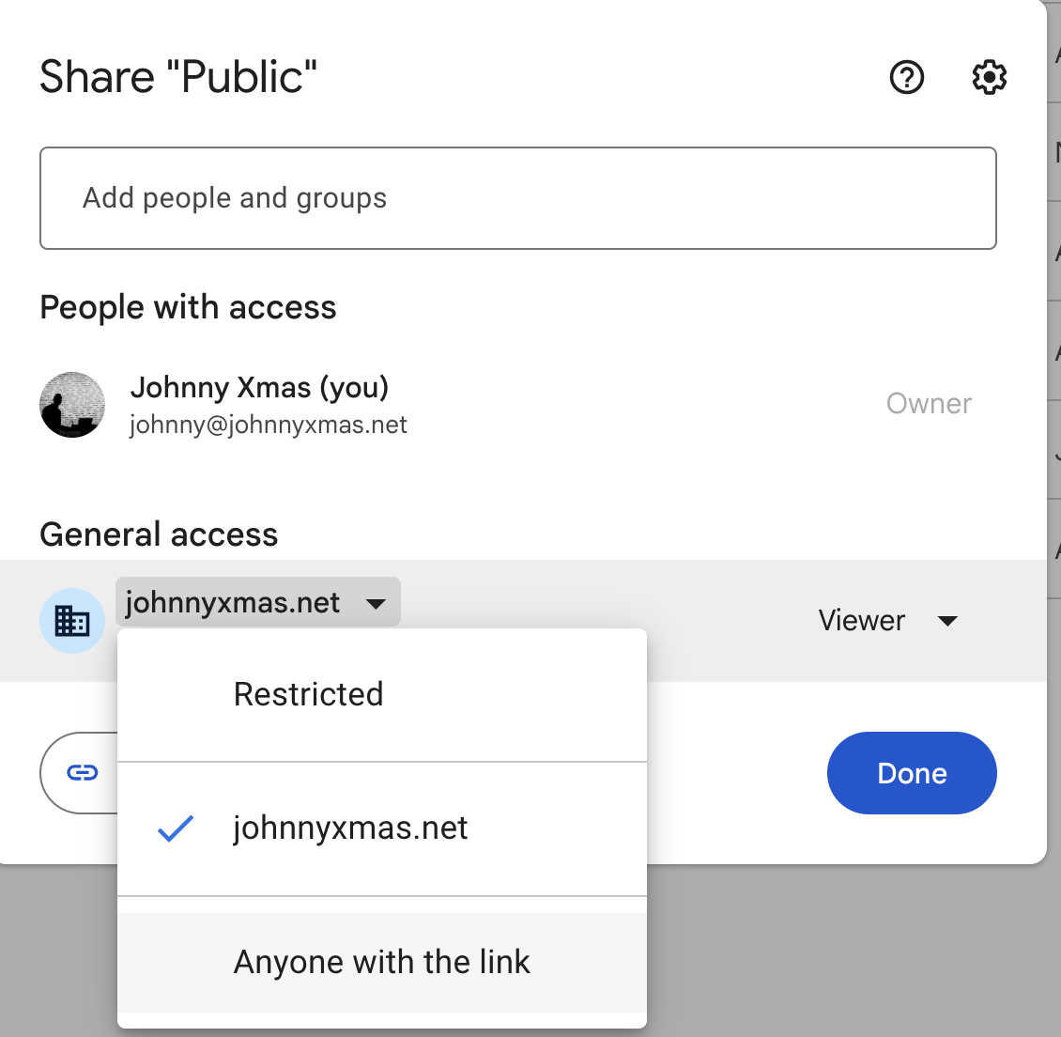
LEAKY LINKS
Discord recently fixed this problem…
OnlyFans has it RIGHT NOW.

Slide 20
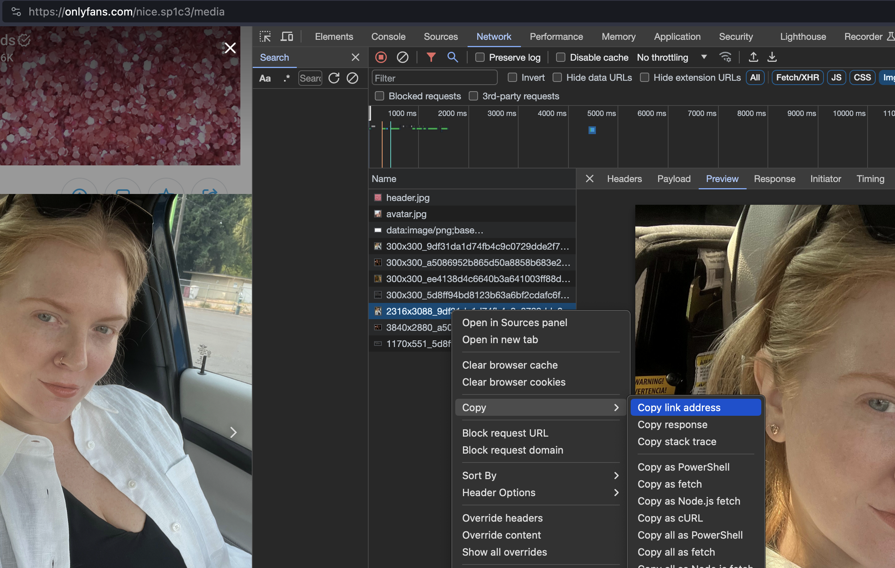
LEAKY LINKS

Slide 21
Also: Actual Hax

Slide 22

INSECURE APIs
Most interactive web “sites” are actually applications (“web apps”)
App uses an “Application Programming Interface” to send/receive info & assets
Many are way too trusting

Slide 23



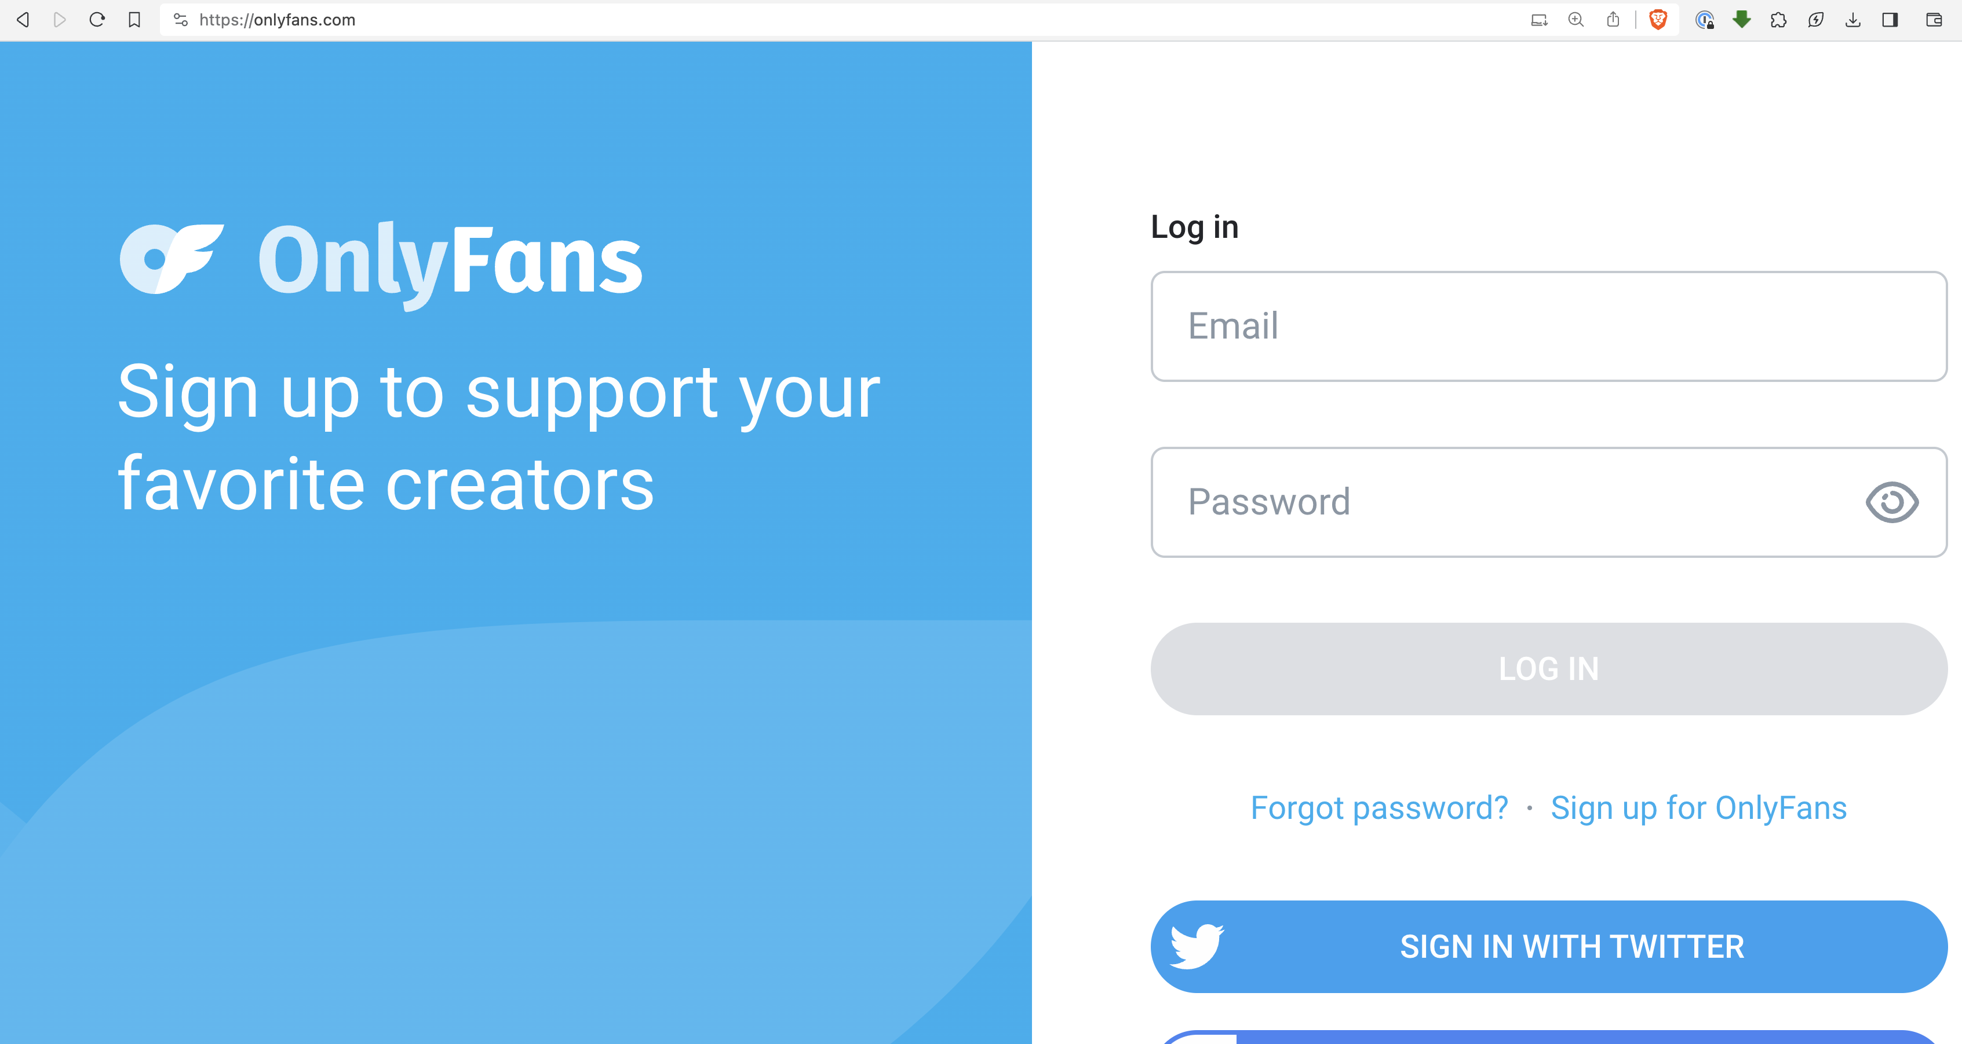


INSECURE APIs
$

Slide 24
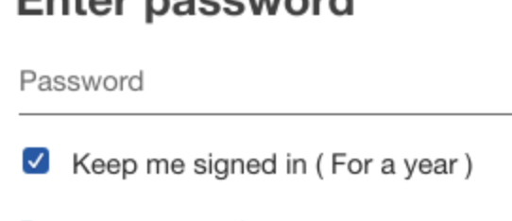
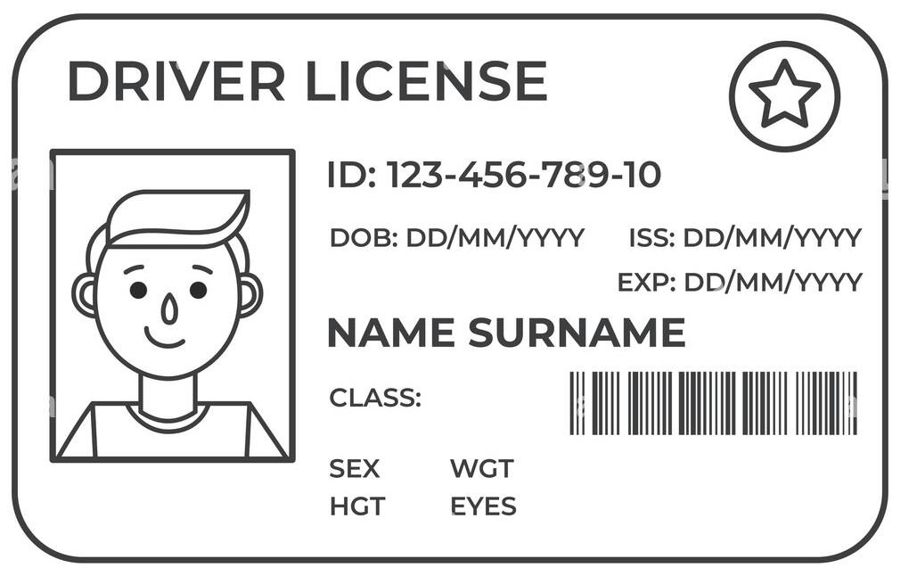


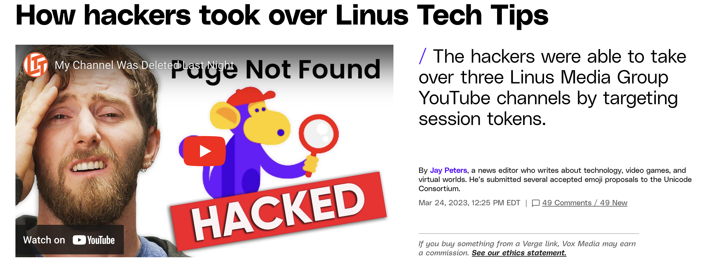
Session Token Theft

Slide 25
Session Token Theft
Stolen via browser or directly from the files in your computer
Most often using malicious links in emails or malicious sites
Sometimes requires no user interaction (“drive-by” attacks)

Slide 26
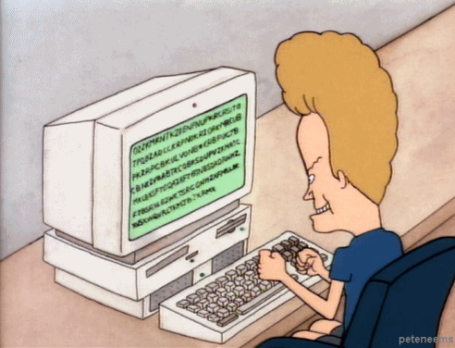
Other Hacks
RATs (Remote Access Terminal) - Mainly for spying via cams but can enable file access
Compromised communication apps
Apps which are fully-functional and useful but cheating on you on the backend

Slide 27
MITIGATING CONTROLS

Slide 28
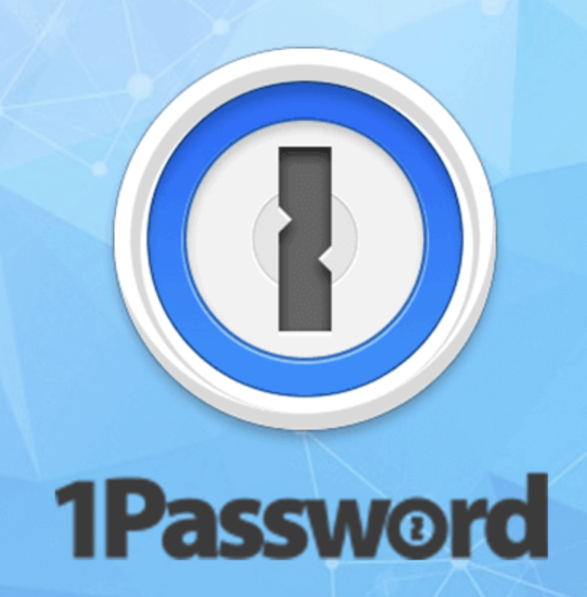
MITIGATING CONTROLS
Use a *good* password manager
Bank & PW Manager PWs should be long, memorized and never digitally documented
Use extremely long, complex and unique passwords
Enable MFA wherever possible

Slide 29
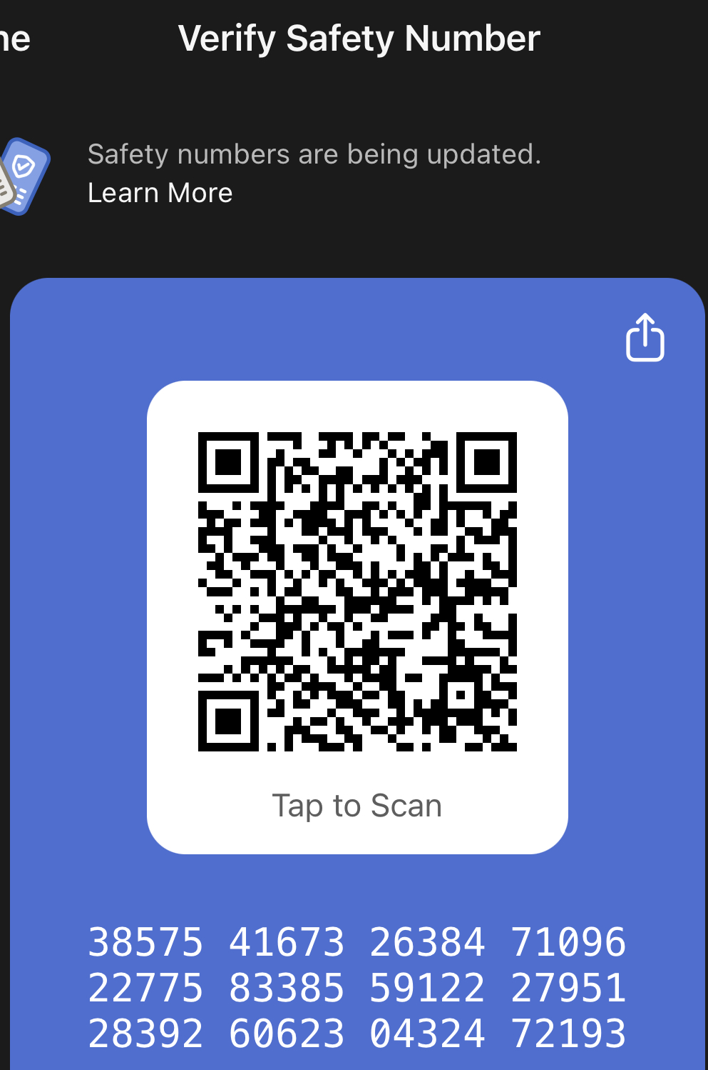
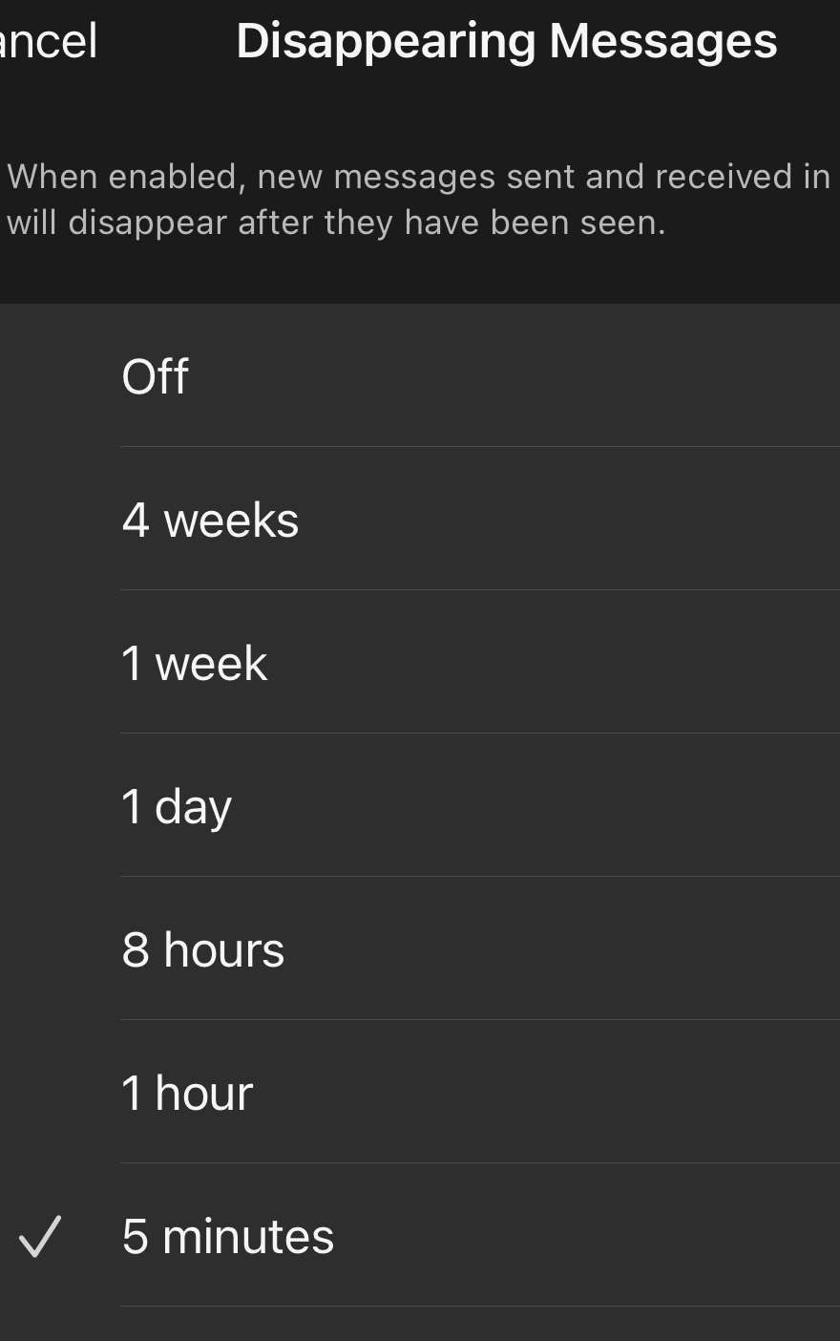
MITIGATING CONTROLS
Operate with a conscious understanding that digital privacy is nonexistent
Do not store or transmit anything private using systems you do not control
Use comms with E2E encryption
Verify the recipient & set short message expiration times

Slide 30

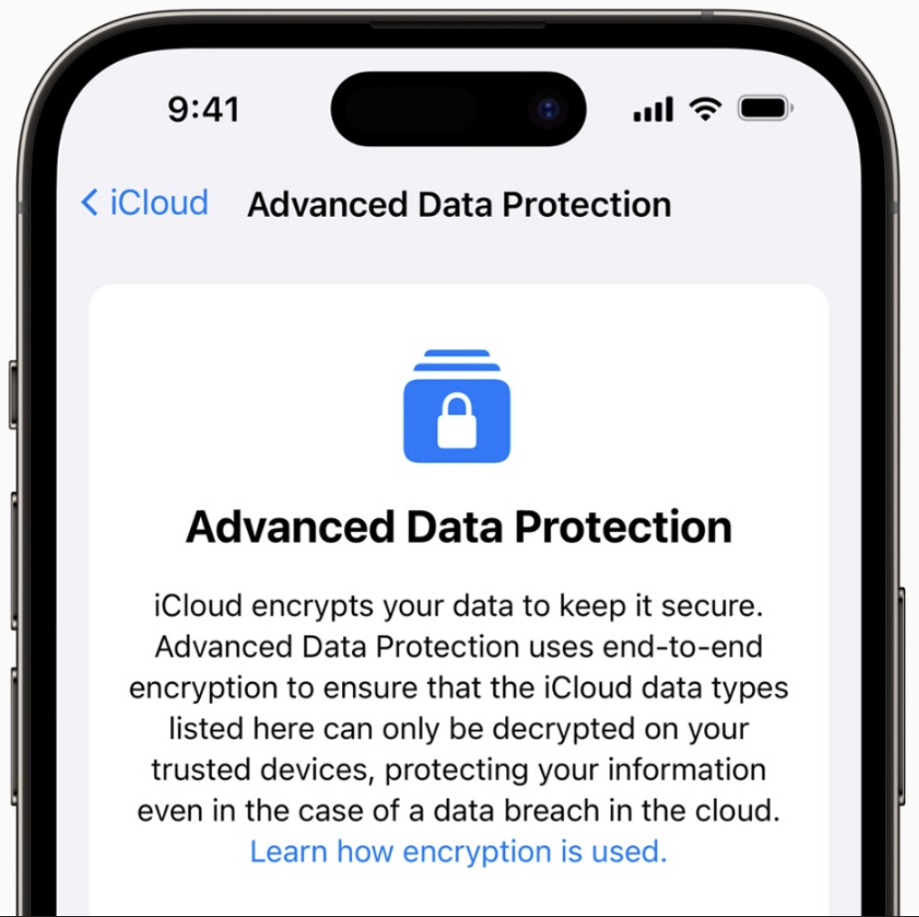

MITIGATING CONTROLS
Obscure your face \ ID features
Can still be fun! Extreme makeup, masks, or Snap Lenses
“Zero Knowledge” Data Backups

Slide 31

SAVING RYAN’S PRIVATES
Johnny Xmas, CISSP, GIAC
Technical Director of Training, GRIMM
https://grimm.rip

